Slide 1

Alice
Notes:
To use this title animation slide with a new image simply 1) move the top semi-transparent shape to the side, 2) delete placeholder image, 3) click on the picture icon to add a new picture, 4) Move semi-transparent shape back to original position, 5) Update text on slide.

Slide 2

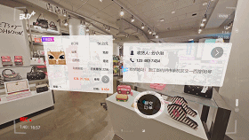

USECASES
Alice
It is a Virtual Reality application which provides 360 degree immersive shopping experience. Alice will give an in-store engagement to you that will help you navigate a store/room and find products.
Transportation
Shopping
Gaming

Slide 3

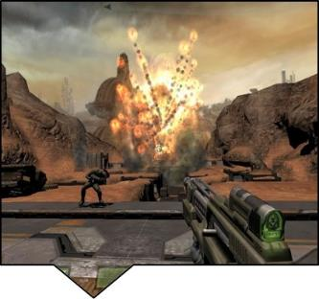

Unity 3D
Unity3D is a commercially available multiplatform game engine used for the production of 2d and 3D video games as well as non-game interactive simulations and visualizations.
Battlestar Galactica
Assassins Creed : Identity

Slide 4

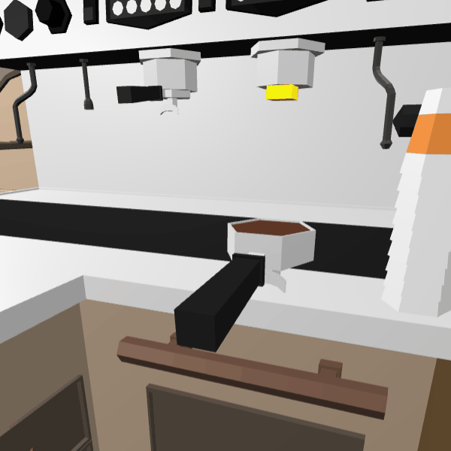
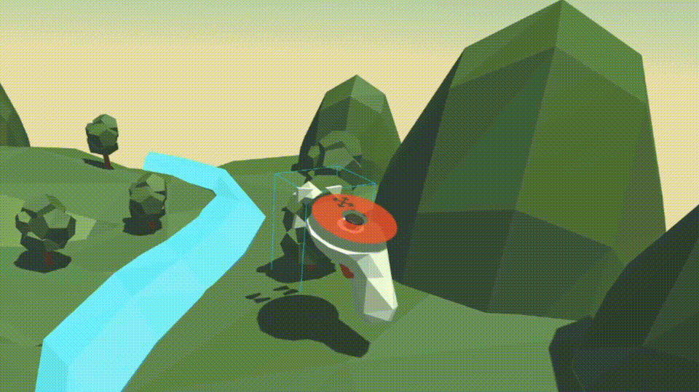
A - Frame
Its an open source web framework for WebVR. It has been developed from three.js

Slide 5
POV on the Unity 3d vs A-Frame
1
SNo | Features | Unity 3D |  | A-frame
 |  | Ratings | Comments | Ratings | Comments
1. | Distribution Type |  | It is commercial |  | It is an open-source application
2. | Installation |  | Premium account required Memory : 9 GB Time consumption : 2-3 hours |  | No installation Contains basic HTML tags Work on Visual Studio code, Vue etc.
3. | Prerequisite Languages |  | Requires complete knowledge of : - C# - Java Script |  | It requires basics of: - HTML - CSS - Vue js

Slide 6
POV on the Unity 3d vs A-Frame
2
SNo | Features | Unity 3D |  | A-frame
 |  | Ratings | Comments | Ratings | Comments
4. | Portability |  | Involves large executable files Challenge in porting to other environments |  | Portable across various platforms No pre-requisite required
5. | Extensibility |  | Difficult without prior knowledge Undergoes a lot of processing steps |  | Similar to adding a new webpage Avoids compilation and building
6. | Learning Period |  | 4-5 weeks Tutorials and external self-learning guides are compulsory. |  | 2-3 weeks Self-learning content by A-frame is enough

Slide 7






POV on the Unity 3d vs A-Frame
3
SNo | Features | Unity 3D |  | A-frame
 |  | Ratings | Comments | Ratings | Comments
7. | Application development |  | Development tool : IDE available Inspection tool : Unavailable Testing tool : HMD & multiple machines |  | Development tool : Inspection tool : CRT+ALT+I Testing tool : Web browser
8. | Deployment |  | Builds using Java Interpreter and deploys |  | Direct deployment
9. | Platform supported

Slide 8
CONCLUSION
Unity 3d although supports Game engine at its best. It is requires a bit of hardware components for a complete VR environment development which puts it back behind the A-frame when it comes to Ease-of-use and .

Slide 9
THANK YOU

